Slide 1
Aruco Data: Digital Camera Experiment

Slide 2
Relevant Information
Uso de Aruco Markers como fiducial markers.
When cv2.aruco.detectMarkers detects a tag, it gives us the coordinates of the tag corners, starting from the top left, and proceeding in a counter clockwise direction around the tag.
If we use the tag as the origin for a right handed - coordinate system, and place the origin at the center of the tag, then we find the 3D coordinates of the corners and the markers.
Now that we have both the 2d coordiantes, and the corresponding 3d coordinates, for corners of each tag, we can now find the relationsip between the camera and the tag.
And now, we can estimate the positions of the markers. ArUco functions return 2 vectors, the translation(position), and rotation of the markers. These vectors are the position and rotation of the camera, with respect to the marker. If you need distances or some 3D info, it is totally normal but when you have more than one marker, camera centered info is better option most of the time.
In ArUco tracking blog, I’ve mentioned that we use estimatePoseSingleMarkers function to receive 3D translation(position) and rotation vectors of the detected markers. These vectors are marker centered and if we want to calculate the difference we need to calculate the camera centered vectors for each marker. In XYZ.

Slide 3
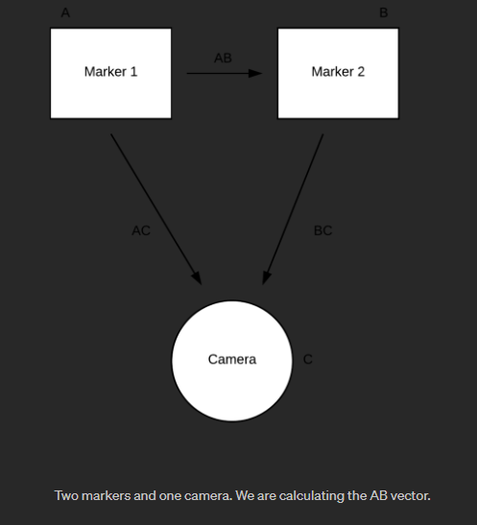
Let’s assume we calculated two markers 3D location. It means we have two vectors, let’s call them A and B vectors. Since their positions are calculated as camera centered, the difference between them will give us marker A as B centered or vice versa, since it’s dependent on the operation(A-B or B-A). But in this case the center its still at the marker. I was able to invert the vectors so that the center was the camera calle inverted tvec and inverted rvec

Slide 4
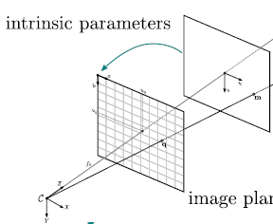
My Setup
Id=5 (0,160cm,0)
BLUE LINE: distance of camera to wall aligned with the vertical. 2 points A: (0,0,2m) and B:(0,0,2.91m).
Id=4 (0,85cm,0)
Id=3(13cm,85cm,0)
ORANGE LINE: hight of camera is (0,85cm,200cm) so its aligned with marker 4.
GREEN LINE: hight of camera is (0,85cm,200//291cm) so its aligned with marker 4 at (0,85cm,0). Id 5 is above marker for at (0,160,0) and marker 3 is slightly to the right at (13cm,85cm,0)
A
B

Slide 5
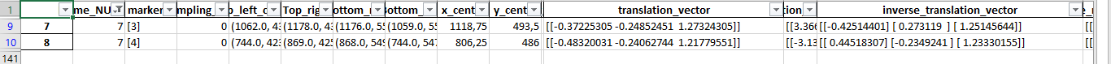
TEST 1
I took the video from point A at 2m form the wall to see if the distance between marker 4 at the center and 3 was correct as the physical measurement was 13 cm between the centers of the markers. Results of a single frame of video (no movement ocurred)
Are these the correct physical distances?? The Z distance is wrong and the information on the x axis is 11cm in difference so there is a 2cm error. Rotations are of no interest at this time.

Slide 6
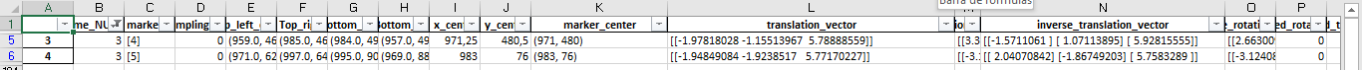
TEST 2
I took a video from point B to evaluate the distances from the marker 4 and 5 which lie in the same Y axis separated form a distance of 75cm. Taking the info of a single frame.
As we can see there is a 77cm difference in the Y axis but why the negative sign? and why is it 1.92 instead of 0.92? The Z axis again is almost the double of the real distance to the wall (2,91m).

